Slide 1
Assignment 3
FieldLab 8: Analytics of COVID trends data
Members: Milou Schamhart, Hielke Muizelaar, Christie Bavelaar, Danielle Rachman, Kenneth Fargose

Slide 2
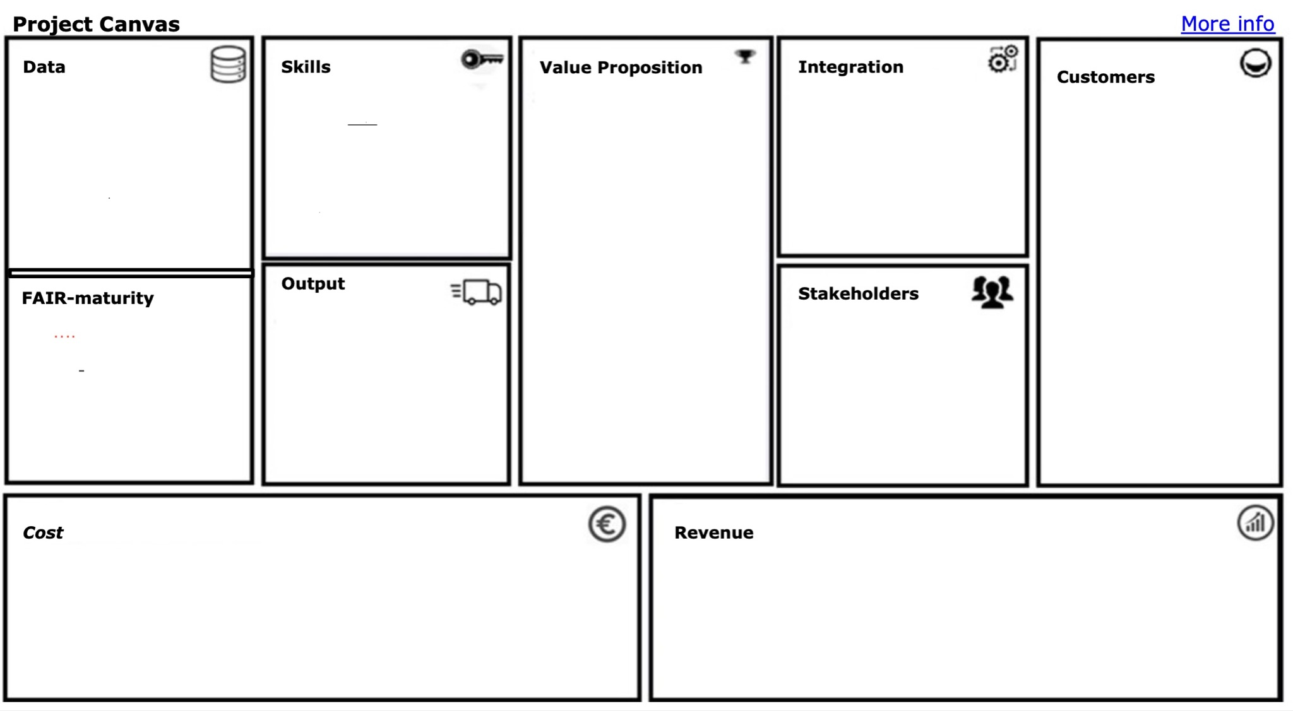
The data consists of two Excel sheets (datasets). The first one concerns COVID-19 media reports. It has columns on the subject of the report and the amount of affected people in the relevant area. The second sheet contains data from interviews with people from vulnerable groups.,That being the contents of the interview as well as information about the interviewee.
Data Science
Machine learning
Statistics
Business / economics
Python
Data visualization
Healthcare in developing countries
Health domain knowledge
Social media analytics
Presenting / academic writing
Integrate media and interview data to be able to draw conclusions on the basis of both of them.
The initial data analysis will illustrate how media data can be used to visualise trends of COVID19 in vulnerable groups. This will form the basis of data analysis in vulnerable groups using media sources which can thereafter be built upon further development of trend monitoring in this population group.
Researchers: The data used and analysis performed in this research will be made available publicly so that other researchers can benefit from this. The team working with this data can hereby benefit from our work. Also other scientists, especially in the (COVID) health domain and the data analytics domain, can get new insight in what is known about prevalence of COVID.
Journalists: The analysis made during this research can be written about by journalists to inform the public about the insights.
Government: The government could possibly use the analysis about COVID prevalence for policies / policy planning.
The datasets are structured via the CEDAR template in a FAIR way. CEDAR uses semantics to adhere to the principles of FAIR. It makes use of tools that provide a baseline for semantic interoperability, such as clear searching for terms and ontologies and customization of output..
Tool that can be used to import data in bulk into the FAIR CEDAR template. Initial analysis and data visualization of trends in the data.
Health data analysts
Healthcare professionals
Health policy makers
Vulnerable groups
Various ministries (health, employment, education, social welfare)
TIme
- 5 students, 168 hours, 3 months
Computational time/resources
- Computational complexity is likely moderate,
Average requirements for data analytics, bulk input tool and data management.
Health Ministry: Saving working hours to bundle and analyze
healthcare statistics of the vulnerable areas
Accurate Data- More accuracy of healthcare data evaluation leading to more effective decision making in healthcare provision for the people especially people who are vulnerable

